Slide 1


Smart Credit Predictions
Shuteng, Dean, Leila

Slide 2
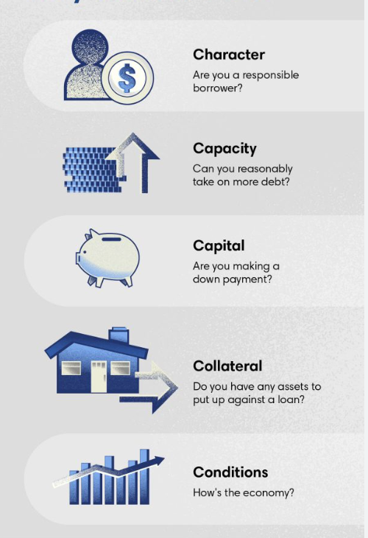
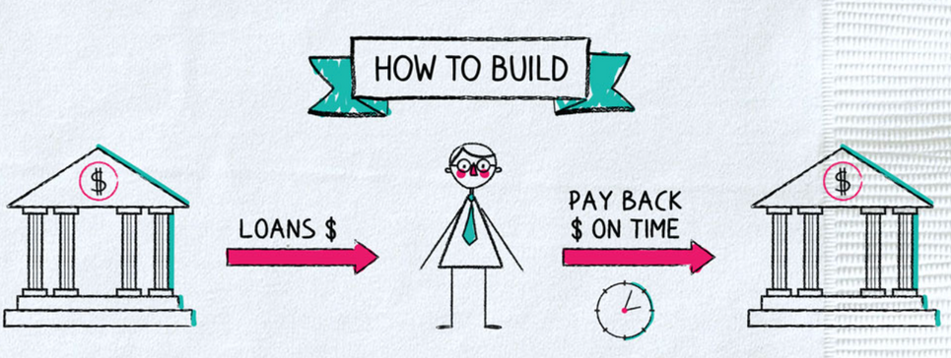
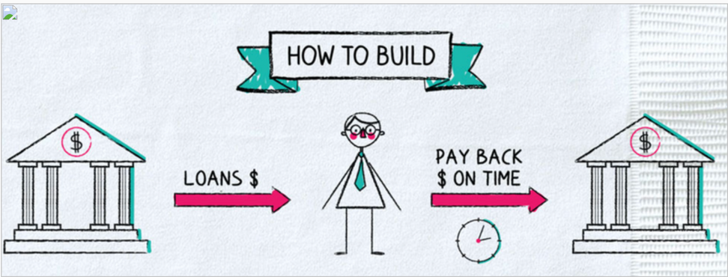
In general, how do banks decide if you’re a good credit risk for a loan?
They use the 5 C’s of credit

Slide 3






Our goal: What features cause people to have overdue credit payments?
Features Explored:
Prediction:
Employment & Income
Years employed
Total income
Personal Information
Age
Education Level
Family and assets
Family/Marital Status
Properties Owned
We will be predicting whether a credit card applicant is a "good" or "bad" client, based on historical data and features derived from their application

Slide 4

Our Data
ID | Income | Age | Marital Status | Student | On Time
43583 | 121500 | 45 | Married | 0 | 0
281472 | 360000 | 30 | Single | 1 | 1
570404 | 126000 | 26 | Single | 1 | 0
648705 | 180000 | 58 | Married | 0 | 1
760580 | 107500 | 63 | Married | 0 | 0

Slide 5
01
Data Exploration

Slide 6

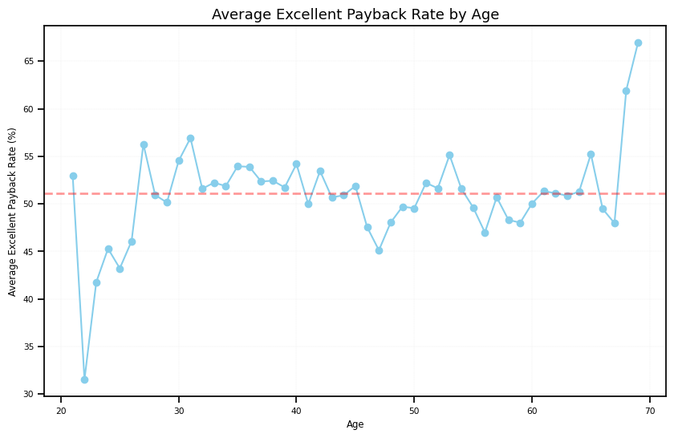
Age
Average: 51%
< 30 lower payback rate
30-70 hover around the same
> 70 highest payback rate

Slide 7
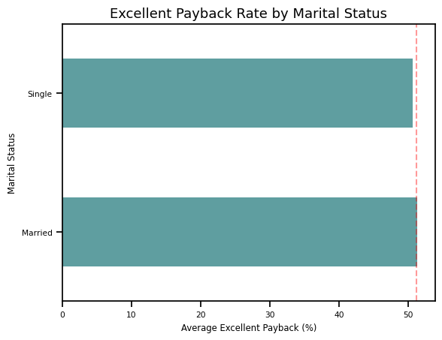
Family Status
Average: 51%
Overall, married & single individuals similar payback rate
However, single slightly below average

Slide 8
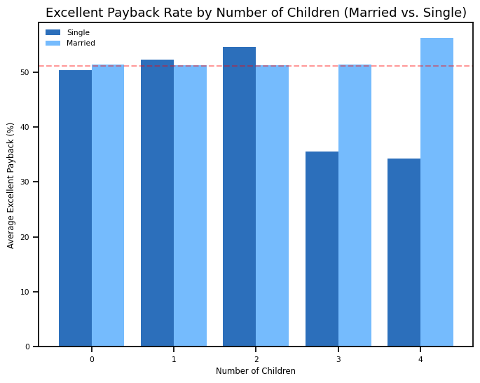
Family Status
Average: 51%
single individuals:
significantly lower payback rate 3+ children
married individuals: average or above
dual-income household

Slide 9
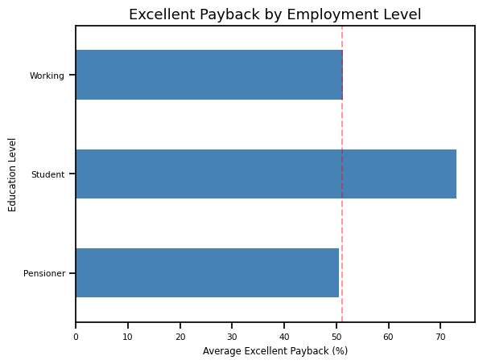
Employment Type
Average: 51%
Less students in data
shorter credit history
Working & pensioner around average

Slide 10
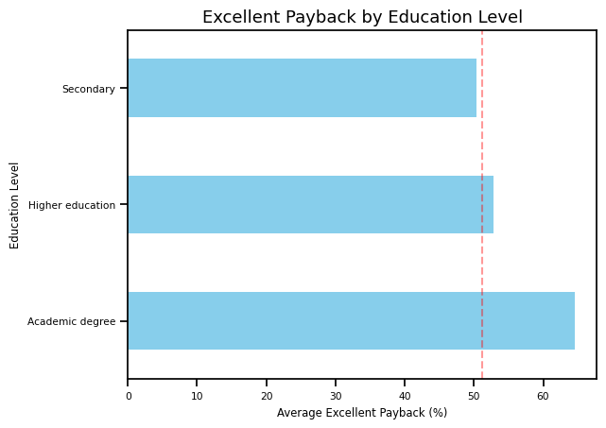
Education Level
Average: 51%
With college degree higher payback rate
Higher education: undergradute degee
Academic degree: postgraduate degree
Secondary: completion of high school/middle school

Slide 11
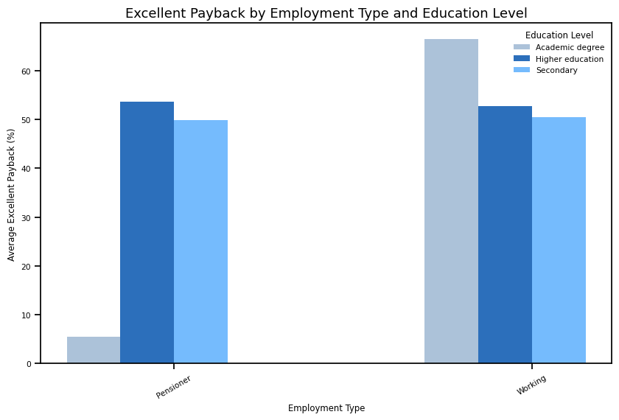
Employment Type & Education Type
Average: 51%
working with postgraduate degree highest payback rate

Slide 12



Data Preparation
Dataset Merge
Created Target Variable
Combined two datasets using inner join to ensure only applicants with complete data were included
Caculated each applicant’s on-time payment rate
Defined applicants as “Good Clients (1)” if their on-time payment rate ≥ 75% and “Bad Clients (0)” otherwise

Slide 13



Data Preparation
Processed Categorical Variables
Handled Class Imbalance
Feature Scaling
Used one-hot encoding to convert categorical features (e.g., education level, employment type, marital status) into binary (0/1) columns
Applied StandardScaler to standardize numerical features like years employed, total income, and age
Used SMOTE (Synthetic Minority Over-sampling Technique) to balance the dataset by oversampling the minority class
Notes:
Over Double the amount of 0's than the amount of 1's
Helped scale values like Total income to be more inline with values like age and years employed.

Slide 14
Definitions:
Decision tree
predictive model that splits data into branches to make decisions based on features
Models
Random Forest
group of decision trees that predicts the class (or value) of a data point by aggregating the results of multiple trees

Slide 15
Definitions:
TN | FN
FP | TP
Confusion Matrix
Bad (0)
Simple table that shows how well a classification model is performing by comparing its predictions to the actual results
True
Good (1)
Bad (0)
Predicted
Good (1)
Notes:
True Positive (TP): The model correctly predicted a positive outcome (the actual outcome was positive).
True Negative (TN): The model correctly predicted a negative outcome (the actual outcome was negative).
False Positive (FP): The model incorrectly predicted a positive outcome (the actual outcome was negative).
False Negative (FN): The model incorrectly predicted a negative outcome (the actual outcome was positive).

Slide 16
02
Decision Tree

Slide 17
Decision Tree
Columns selected: Car Ownership, House Ownership, Total Income, Number of Children, Number of Family Members, Years of Employment, Age
Chosen based on their relevance to financial responsibility
Predicting: On time payments
Notes:
Things like whether or not they had a phone, email, work-phone, and their education type didn't affect the model as much

Slide 18
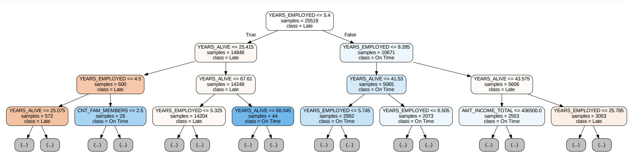
Decision Tree
Notes:
Employment duration & age are the most significant predictors.
People with less than ~5.4 years of employment tend to be Late.
Older individuals tend to have a higher probability of being On Time.
Features like family size and income play a secondary role.
samples: The number of data points at that node.
value: Class distribution

Slide 19
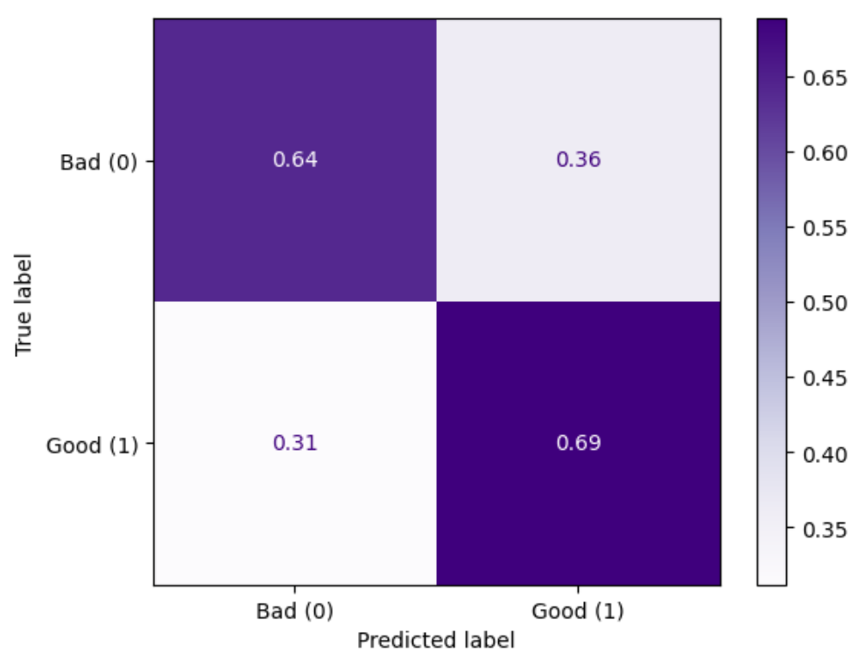
Confusion Matrix
~ 67% accurate

Slide 20
03
Random Forest

Slide 21
Random Forest
Columns selected: Car Ownership, House Ownership, Total Income, Number of Children, Number of Family Members, Years of Employment, Age, Gender, Education Level, Marital Status, Housing Status, Employment Type
Notes:
Things like wether or not they had a phone, email,

Slide 22
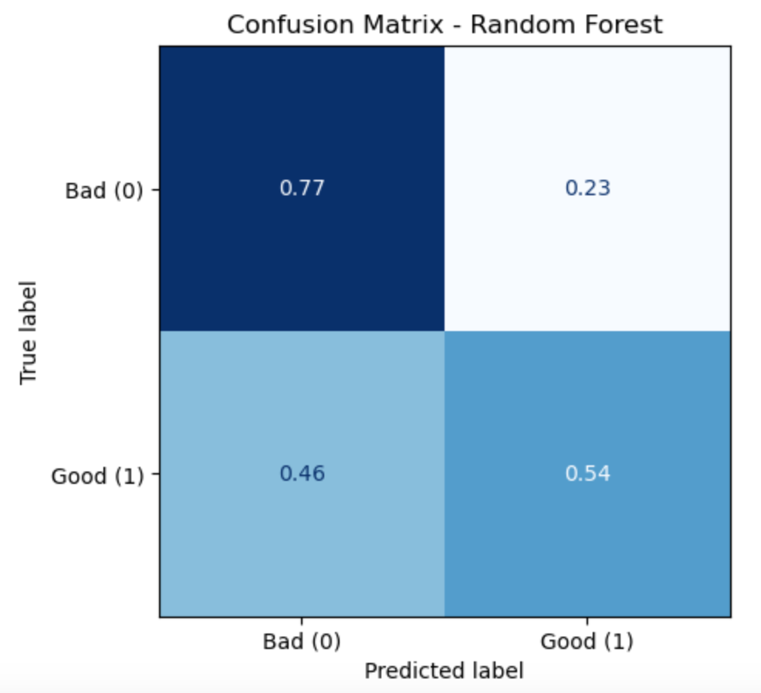
Confusion Matrix
~ 70% accurate

Slide 23

Model Comparison
Metrics | Decision Trees | Random Forest
Accuracy | 0.67 | 0.70
True Positive Rate | 0.69 | 0.54
True Negative rate | 0.64 | 0.77
False Positive Rate | 0.36 | 0.23
False Negative Rates | 0.31 | 0.46
Precision | 0.48 | 0.54
Random Forest Model:
True Negatives:
71% only completed high/middle school
> 80% of applicants have at least one child
Decision Trees Model:
True Positives:
70% of people had no children
67% of people owned their home

Slide 24
Model Comparison
Random Forest
Decision Tree
handles non-linear relasionships
reduces overfitting -> higher accuracy
prone to overfitting
feature importance
sensitive to small changes in data
harder to interpret as model gets larger
easy to understand & interpret
biased towards dominant class

Slide 25


Conclusion
Analysis
higher education = higher on-time payback rate
more children = lower on-time payback rate
home ownership = higher on-time payback rate
Models
Decision Tree: can identify specific patterns for true positives (paying on time)
Random Forests: more robust, better handling true negatives (not paying on time) due to their ensemble nature & ability to generalize

Slide 26
Thank You!

